Slide 1
What is Credit Risk?
When a bank receives a loan application, based on the applicant’s profile, the bank has to make a decision regarding whether to go ahead with the loan approval or not.
Two types of risks are associated with the bank’s decision –
If the applicant is a good credit risk, i.e. is likely to repay the loan, then not approving the loan to the person results in a loss of business to the bank
If the applicant is a bad credit risk, i.e. is not likely to repay the loan, then approving the loan to the person results in a financial loss to the bank

Slide 2
Objective of Analysis
Minimization of risk and maximization of profit on behalf of the bank
To minimize loss from the bank’s perspective, the bank needs a decision rule regarding who to give approval of the loan and who not to
A predictive model developed on this data will provide a bank manager guidance for making a decision whether to approve a loan to a prospective applicant based on his/her profiles

Slide 3
German Credit Data
Credit Data
Source: UCI Machine Learning Repository
It contains data on 20 variables and the classification whether an applicant is considered a Good or a Bad credit risk for 1000 loan applicants.
Categorical Attributes: 17 Account Balance, Credit History, Purpose, Value of Savings Account/Bonds, Present Employment Since(years), Personal Profile, Other Debtors/ Gurantors, Property, Present Residence Since, Housing, Number of Dependents, Telephone, Foreign Worker, Installment Rate, Job, Other Installment Plans, Number of existing credits
Numerical Attributes: 3 Credit Amount, Duration(months), Age
Outcome Variable: Creditability: 700 credit worthy(1), 300 Not worthy(0)

Slide 4
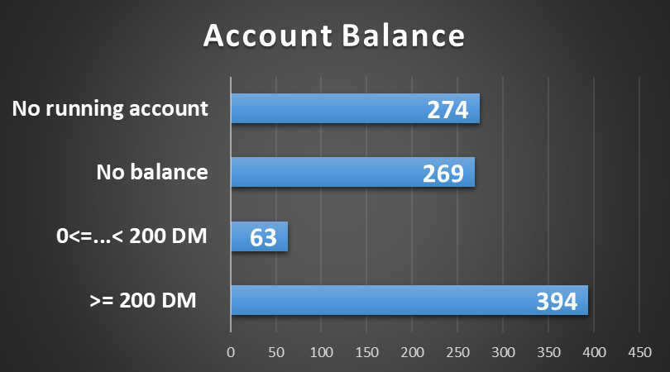
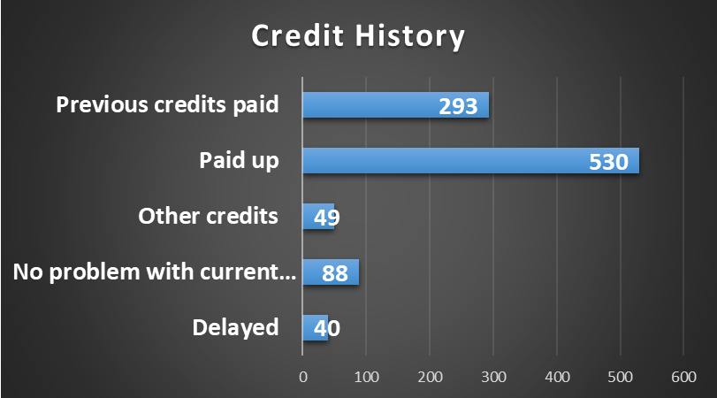
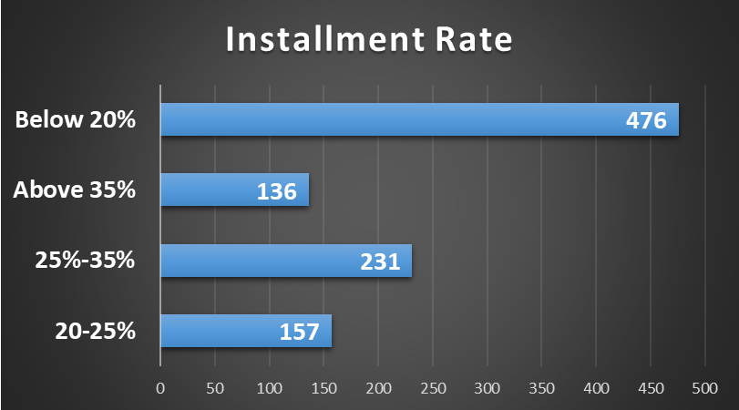
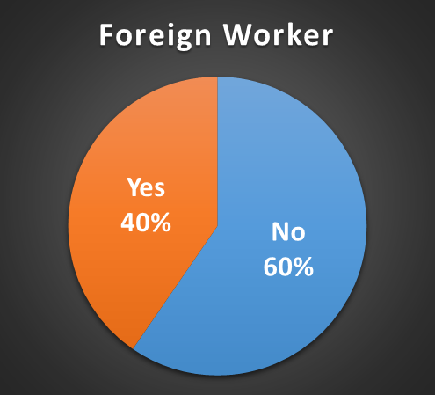
Exploratory Data Analysis

Slide 5

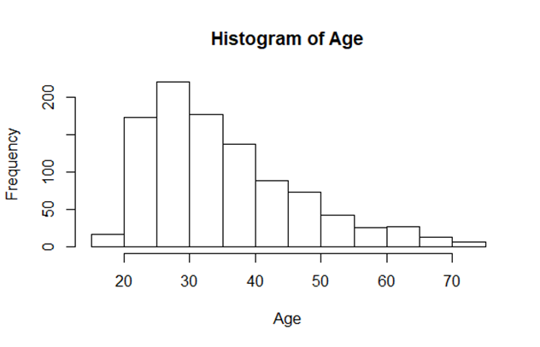
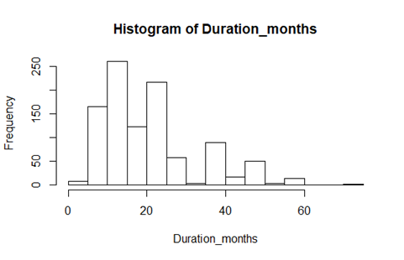
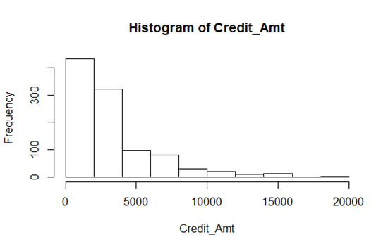
Exploratory Data Analysis(Cont.)

Slide 6
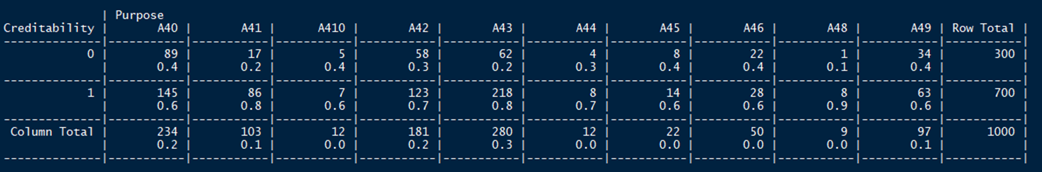
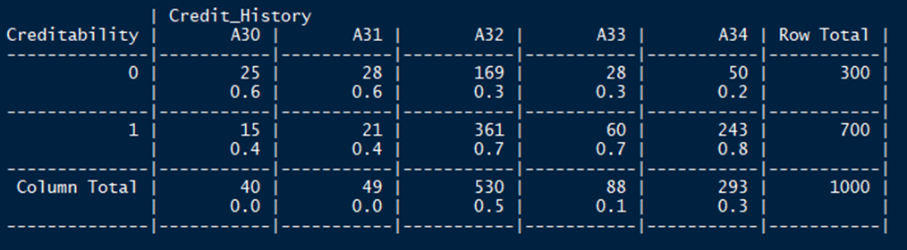
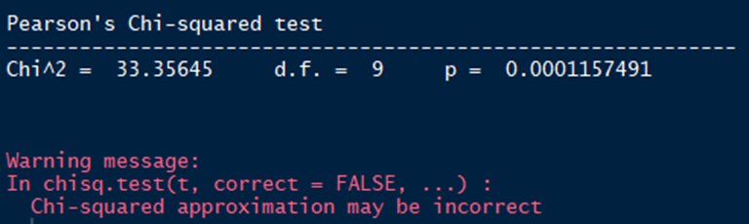
Feature Selection- Chi Square Test

Slide 7


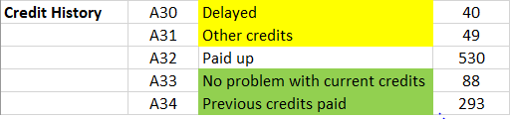

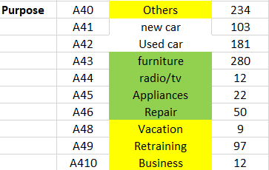

Regrouping Variables in Smaller Classes

Slide 8
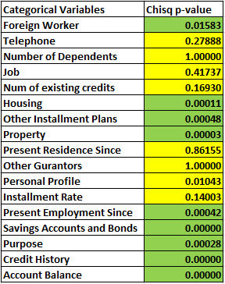

Chi-Square test of Independence/ t-test
Identifying significant predictors for the model
Formula: Creditability ~ Input variable
H0: Null Hypothesis – The outcome and predictor variable are independent.
Level of significance: 5%
If p-value < 0.05, Reject the Null Hypothesis, i.e. Select that predictor variable for modelling.

Slide 9
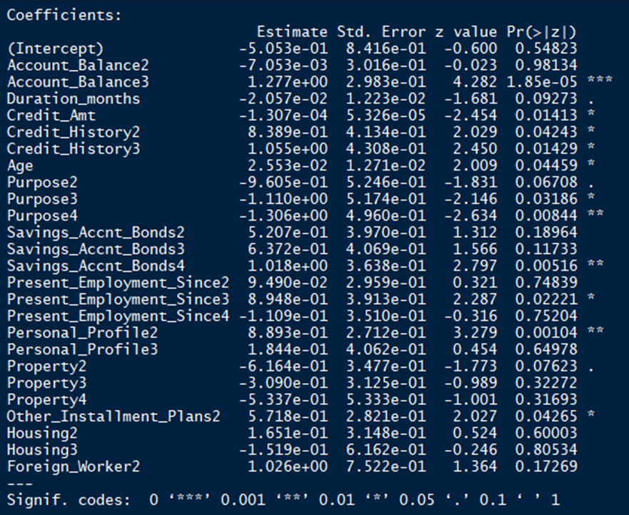
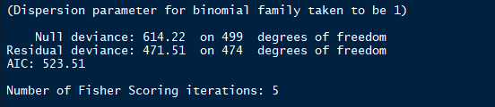
Logistic Regression Model- Iteration 1
Splitting into training and test set 50/50
Random samples
Training Data Size: 500
Test Data Size: 500

Slide 10
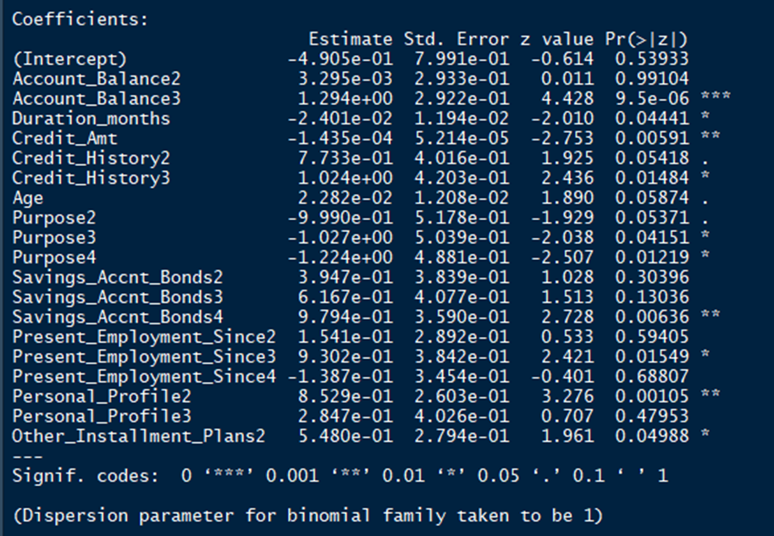
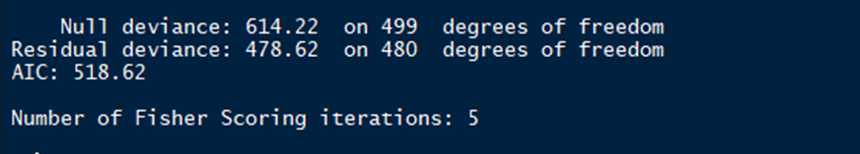
Logistic Regression Model- Iteration 2(final)
Removing variables beyond 10% significance and run again
AIC value is lowest for this model.

Slide 11
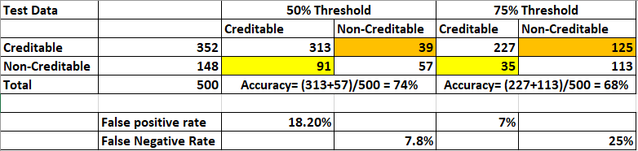
Final LR Model- Confusion Matrix
Logistic Regression gives Probability of test data between 0 and 1.
For 50% Threshold, if Prob >=0.5, classify as 1(Credit Worthy) , else 0 (Not credit worthy)
For 75% Threshold, if Prob >=0.75, classify as 1(Credit Worthy) , else 0 (Not credit worthy)

Slide 12
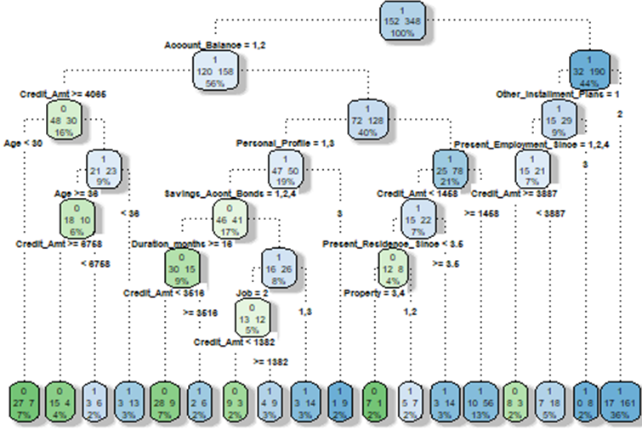
CART - Decision Tree(all variables)
Supervised Learning algorithm
Works for both categorical and continuous input and output variables
It splits the population or sample into two or more homogeneous sets (or sub-populations) based on most significant splitter / differentiator in input variables
GINI INDEX
Creates binary splits
Splits based on homogeneity of sub-nodes
Higher the index, higher the homogeneity

Slide 13
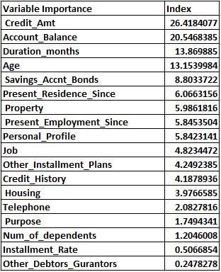
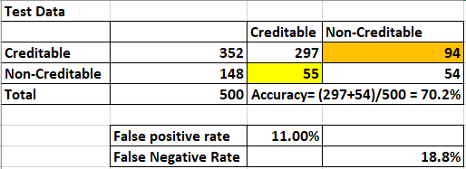
CART - Decision Tree
Confusion Matrix

Slide 14
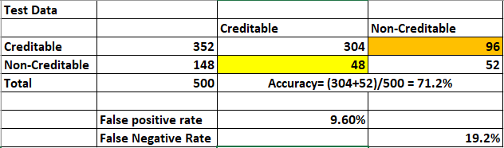
CART - Decision Tree(Pruned)
Pruning reduces the size of decision tree by removing sections of the tree that provide little power to classify instances.
It reduces the complexity of the final classifier, and hence improves predictive accuracy by the reduction of overfitting.
Confusion Matrix

Slide 15
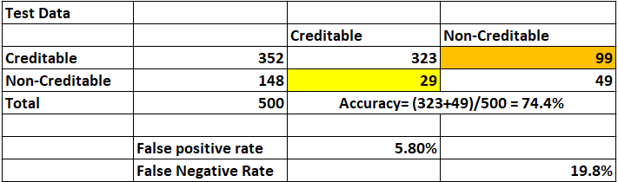
RANDOM FOREST
In Random Forest, we grow multiple trees as opposed to a single tree in CART model.
To classify a new object based on attributes, each tree gives a classification and we say the tree “votes” for that class.
The forest chooses the classification having the most votes (over all the trees in the forest).

Slide 16

Cost Profit Consideration
If bank predicts a loan applicant to be credit worthy and it actually turns out to be credit worthy, then let’s say the profit is 35%.
If bank predicts a loan applicant to be good but it turns out bad, the loss is 100%.
If the bank predicts an application to be non-creditworthy, then loan facility is not extended to that applicant and bank does not incur any loss (opportunity loss is not considered here)

Slide 17
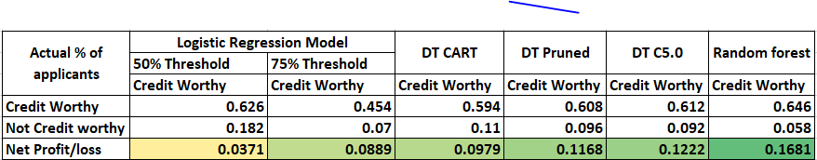
Cost Profit Consideration(cont.)
To check the cost-profit scenario for each model, we multiply the model outcomes(percentage) with the cost matrix and sum it vertically to find the model with maximum profit.

Slide 18
THANK YOU

